Slide 2
1. Introduction
1.1 Brief introduction
1.2 Previous researches
1.3 Project description
1.4 Team building
2. Function presentation
2.1 System blue print
2.2 Intel Edison
2.3 Sony smart eye glass
2.4 Car detection
3. Results & Discussion
3.1 Achievements &Failure
3.2 business potential
3.3 More prospects

Slide 3
1.1 Brief Introduction

Slide 4
1.2 Previous Researches

Slide 5
1.3 Project description

Slide 6
1.4 Team building

Slide 7
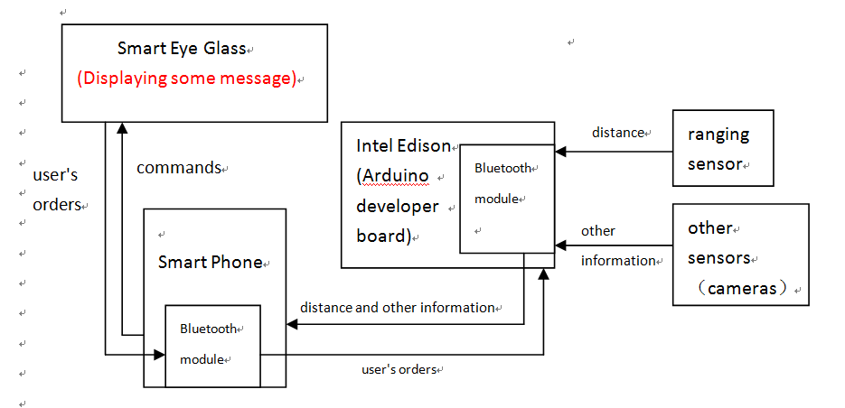
2.1 System blue print

Slide 8
Three devices:
Sensors
intel Edison
Sony Smart Eye Glass
Three programs
Smart Eye Glass simulation system
Cars detection system and the HUD system
Intel Edison Arduino program

Slide 9
2.2 Intel Edison

Slide 10
2.3 Sony smart eye glass

Slide 11
2.4 Car detection
Using a machine learning technique to detect cars
Haar features + Adaboost
Why machine learning?
Complicated environment
Multiple interference
Moving objects

Slide 12
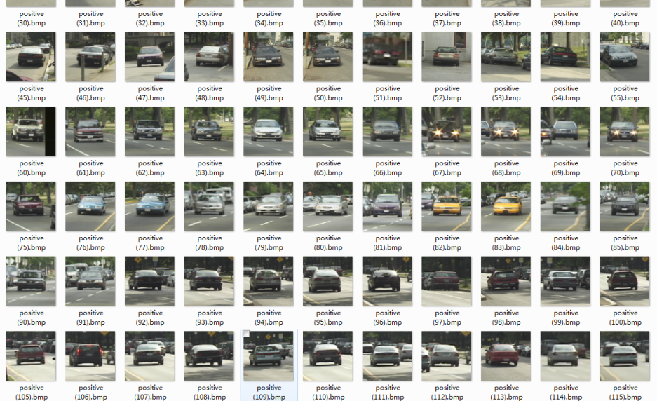
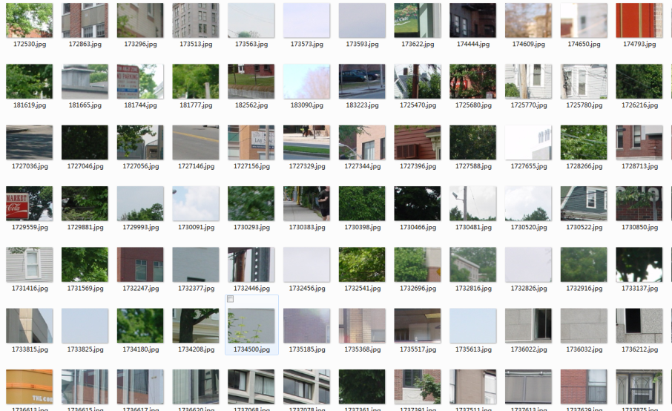
Haar features + Adaboost
Positive examples
Haar Feature
Negative examples
training
Adaboost
Model file

Slide 13
Other improvements
Image preprocessing
Frame processing
Decrease the error rate

Slide 14
Results
Success : 41.67%
Errors: 13%
Omissions: 58.3%
Limitations :
Small scale of training data
Complicated road environment
Improvements:
Using motion detection
Try other features: HoG, symmetry, shape of shade…
More preprocessing

Slide 15
3.1 Achievements &Failure

Slide 16
3.2 business potential

Slide 17
3.3 More prospects

